Slide 1
Web Backend: Databases
Link to this document
Applied Python

Slide 2
What are we doing?
Learning Objectives
By the end of this week, you should:
understand the purpose of databases
identify the features of a database
know how to interact with an API
Measurable Outcomes
By the end of this week, you should be able to:
create and query a database
mutate data in a database
interact with an external API

Slide 3
DATABASES

Slide 4
Databases: welcome
A database is a tool for collecting and organizing information. Databases can store information about people, products, orders, or anything else. Many databases start as a list in a word-processing program or spreadsheet. As the list grows bigger, redundancies and inconsistencies begin to appear in the data. The data becomes hard to understand in list form, and there are limited ways of searching or pulling subsets of data out for review. Once these problems start to appear, it's a good idea to transfer the data to a database created by a database management system (DBMS).

Slide 5
Databases: clients and servers
Databases utilize a client/server model:
the client (a computing device) makes a request to the server.
the server (also a computing device, where the data is stored) then acts on that request - assuming it's a valid one.
Requests may come in many forms, including things like (casually) "update this", "delete that", "give me those", etc.

Slide 6
Databases: tables
Typically, a database is a collection of related tables; statements can be issued to the database to read information from it and write information to any of its tables. A database table is where the data is actually stored. It is similar in appearance to a spreadsheet, in that data is stored in rows (also called records) and columns (also called attributes). As a result, it is usually quite easy to import a spreadsheet into a database table. The main difference between storing your data in a spreadsheet and storing it in a database is in how the data is organized.

Slide 7
DATABASE OPERATIONS

Slide 8
Databases: the process
Typically, utilizing a database is done programmatically in three steps:
Acquire a connection with the database.
Issue statements.
Close the connection.
Let's focus a bit on the second step, since it's where a majority of the work is done.

Slide 9
Databases: statements
A database statement can perform many different functions in a database. Their most common function is to retrieve specific data from the tables. The data you want to see is could be contained on one table, or spread across several tables, and statements allow you to view it in a single dataset. Also, since you usually don't want to see all the records at once, statements let you add criteria to "filter" the data down to just the records you want.
A statement to solely retrieve information (i.e. read) is called a query. A statement to change data in the database in some way (i.e. write) is called a mutation.

Slide 10
Databases: syntax
So what kind of syntax does a database actually use? Well - it depends on the database! For this course, you're going to be using a DBMS which uses a syntax called Structured Query Language (SQL) to ask the database to do things. It's not a fully-fledged programming language - but it does allow you to interact with the system.
For this course, there are some syntactic conventions to follow:
Each SQL line must end with a semicolon. (This is true everywhere.)
All SQL keywords will appear in CAPS.
Any user-created attributes or other properties will be in lowercase.

Slide 11
Database commands: CREATE
Before you can actually start querying and mutating data, you've got to have a place to store it. The CREATE operation allows you to make new databases themselves, as well as new tables in existing databases.
CREATE DATABASE
favouriteFoods;
CREATE TABLE IF NOT EXISTS credentials (
username VARCHAR NOT NULL UNIQUE,
password VARCHAR NOT NULL
);
CREATE TABLE IF NOT EXISTS userfoods (
username VARCHAR NOT NULL UNIQUE,
food VARCHAR NOT NULL
);

Slide 12
Database commands: INSERT
The INSERT operation creates a new record or set of records. This is a write operation.
INSERT OR IGNORE INTO credentials
(username, password)
VALUES
('admin', 'passwords'),
('greg', 'securePassword'),
('martin', '456789'),
('kristof', '1234');

Slide 13
Database commands: UPDATE
The UPDATE operation changes an existing record or set of records. This is a write operation.
Notice that there are a couple new keywords here.
SET is the data to be written.
WHERE allows you to specify a condition under which the statement happens.
UPDATE
userfoods
SET
food = 'sprinkles'
WHERE
username = 'kristof';

Slide 14
Database commands: SELECT
The SELECT operation allows you to fetch some information from a table. This is a read action.
Also note: if you ever use an attribute with a space in its name, it needs to be surrounded by grave accents!
SELECT
*
FROM
userfoods;
SELECT
username
FROM
userfoods
WHERE
`food` = 'sprinkles';

Slide 15
Database commands: DELETE
The DELETE operation removes a record or set of records. This is a write operation.
DELETE FROM
userfoods
WHERE
username = 'kristof';
DELETE FROM
credentials
WHERE
username = 'kristof';

Slide 16
SQLITE3

Slide 17
Databases: Python DB-API
The Python standard for database interfaces is the Python DB-API. Most Python database interfaces follow this standard. The Python DB-API supports a wide range of database servers (implementations) including but not limited to:
MySQL (MariaDB)
Microsoft SQL Server
Oracle
SQLite
PostgreSQL
For the purposes of this course, you're going to be using sqlite3 as your Python DB-API.

Slide 18
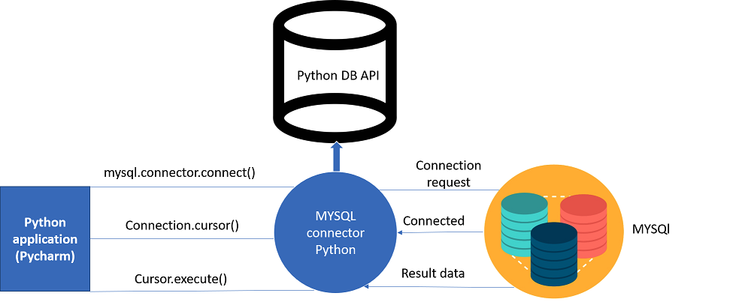
Databases: internal structure
To the right is a block diagram of how the different parts of a Python project which utilizes databases is organized.
source: https://medium.com/@yuiltripathee/connect-your-database-in-python-code-works-almost-everywhere-21637b311bb4

Slide 19
Databases: sqlite3
In order to contextualize databases, you're actually going to build a database from the ground up.
Let's begin by creating a new project and importing sqlite3.
import sqlite3 as sl
def main():
# nothing yet
if __name__ == '__main__':
main()

Slide 20
Databases: create a db
The first thing you'll need for this project is an actual database! Let's do so by establishing a connection with a database.
It turns out that with sqlite3, when you accomplish the first step of the database process - connecting to the database - if the specified database is not found, it will make one.
import sqlite3 as sl
def main():
conn = sl.connect('my_first_database.db')
if __name__ == '__main__':
main()

Slide 21
Databases: the cursor
A cursor is the object which allows for traversal of the database itself, and facilitates executing statements. Creating it is very simple, and once you do, you can execute whatever statements you would like.
import sqlite3 as sl
def main():
# ... previous code goes here
curs = conn.cursor()
if __name__ == '__main__':
main()

Slide 22
Databases: design a statement
Databases work based on being issued statements. For reference, there are several different statements constructed to the right. Each will have a keyword - as discussed earlier - followed by whatever options are appropriate.
import sqlite3 as sl
def main():
# ... previous code goes here
# example statement
stmt1 = "CREATE TABLE IF NOT EXISTS credentials(username VARCHAR NOT NULL UNIQUE, password VARCHAR NOT NULL)"
# another example statement
stmt2 = "INSERT OR IGNORE INTO credentials (username, password) VALUES ('admin', 'passwords')"
if __name__ == '__main__':
main()

Slide 23
Databases: create a table
You're going to need a table in this newly-created database; let's create it now. Each of the values inside the table name parentheses will become a new column.
import sqlite3 as sl
def main():
# ... previous code goes here
stmt1 = "CREATE TABLE IF NOT EXISTS credentials(username VARCHAR NOT NULL UNIQUE , password VARCHAR NOT NULL)"
curs.execute(stmt1)
if __name__ == '__main__':
main()

Slide 24
Databases: add data
Let's add some data to the fruits. This is a mutate statement, as it changes information in the database. (More specifically, it will add a new row.)
import sqlite3 as sl
def main():
# ... previous code goes here
stmt2 = "INSERT OR IGNORE INTO credentials (username, password) VALUES ('admin', 'passwords')"
curs.execute(stmt2)
if __name__ == '__main__':
main()

Slide 25
Databases: get data
Let's query for all items in the table which have a Value greater than 1000.
A SELECT statement will return an iterable object, which means you can iterate through it and do whatever you want with each result - in this case, just print them.
import sqlite3 as sl
def main():
# ... previous code goes here
stmt3 = "SELECT * FROM credentials"
# OR
v = ('Alice',)
stmt3 = "SELECT * FROM credentials WHERE `username`=?"
# THEN
data = curs.execute(stmt3, v)
for record in data:
print(record)
if __name__ == '__main__':
main()

Slide 26
Databases: security
Notice that the previous slide's code used a parameter substitution. This is because Python's string operations are insecure and may leave your code vulnerable to attacks like SQL injections. An explanation of SQL injection attacks can be found here.
In summary: don't use string substitution using modulo!
import sqlite3 as sl
def main():
# ... previous code goes here
# parameter substitution - this is good
v = ('Alice',)
stmt3 = "SELECT * FROM credentials WHERE `username`=?"
# THIS IS BAD DON'T DO THIS
v = 'Alice'
stmt3 = "SELECT * FROM credentials WHERE `username`=%s' % v
if __name__ == '__main__':
main()

Slide 27
Databases: get data differently
If you didn't want to iterate through the entire set of results, you can fetch a result or several results using the following methods.
import sqlite3 as sl
def main():
# ... previous code goes here
curs.fetchone()
# OR
size = 3
curs.fetchmany(size)
# OR
curs.fetchall() # and then iterate
if __name__ == '__main__':
main()

Slide 28
Databases: commit changes
You may notice that every time you rerun your code, the database is there, and the table is there, but there's no data in the table. This is because you haven't properly finalized the changes!
import sqlite3 as sl
def main():
# ... previous code goes here
conn.commit()
if __name__ == '__main__':
main()

Slide 29
Databases: rollback changes
But wait! If you're not satisfied with the changes you've committed and you want to revert back those changes completely, you can roll them back.
import sqlite3 as sl
def main():
# ... previous code goes here
conn.rollback()
if __name__ == '__main__':
main()

Slide 30
Databases: closing connections
The final action you'll want to do when working with databases is closing the connection you made at the beginning.
It’s a best practice to open/connect and close your connections per function.
import sqlite3 as sl
def main():
# ... previous code goes here
conn.close()
if __name__ == '__main__':
main()

Slide 31
Databases: Checklist
Laid out to the right is the convention you'll be using in this course for any sort of database interactions. In other words, write your db functions like this.
def db_function_name(any_params):
Connect
Get a cursor
Execute 1 or more statements
Process data #doWork
Commit changes
Close connection
return

Slide 32
MORE DATABASES

Slide 33
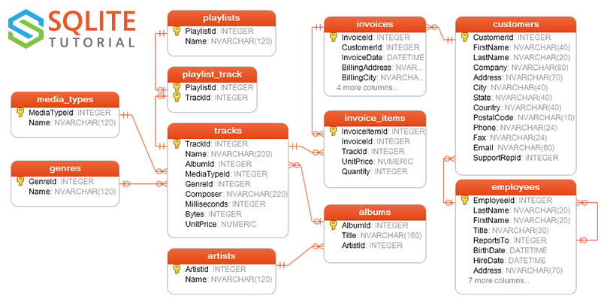
A new database
Let's work with this existing database to see some of the relational information contained within, so that you don't have to assemble it yourself.
The schema (organizational structure) of the database is to the right, represented in an entity-relationship diagram (E-R diagram).
source: https://www.sqlitetutorial.net/sqlite-sample-database/

Slide 34
Databases: data types
You will notice that each attribute has beside it, in gray, some text. This text represents the datatype of the attribute.
Within the genres table:
GenreID is an INTEGER
Name is an an NVARCHAR(120) - effectively, a 120-char long string.

Slide 35
Databases: key attributes
You will also notice that each table contains one attribute with a yellow key beside it. This is the primary key, which is the one column that uniquely identifies each record in the table.
Within the genres table, GenreID is the primary key.

Slide 36
Databases: what tables?
The schema for this database is clearly shown in these slides. However, if you don't have a diagram for your particular database handy, you can at the very least list the table names using SELECT.
stmt = 'SELECT name FROM sqlite_master WHERE type=?'
v = ('table',)
data = curs.execute(stmt, v)
for record in data:
print(record)
>>> ('Album',)
>>> ('sqlite_sequence',)
>>> ('Artist',)
>>> ...

Slide 37
Databases: let's look at genres
It looks like the genres table contains all of the genres of music currently held in the system. Let's list all of them.
It turns out that there are 25, each of which has a particular number associated with it.
stmt = 'SELECT * FROM Genre'
data = curs.execute(stmt)
for record in data:
print(record)
>>> (1, 'Rock')
>>> (2, 'Jazz')
>>> (3, 'Metal')
>>> ...
>>> (25, 'Opera')

Slide 38
Databases: aggregations
Let's aggregate - collapse a collection of records down into one number - the tracks table to count the number of tracks.
stmt = 'SELECT COUNT(*) FROM Track
data = curs.execute(stmt)
for record in data:
print(record)
>>> (3503,)

Slide 39
Databases: aggregating with filter
Let's filter - only select a certain subset of a collection based on a condition - to count only the tracks in the tracks table which are of type "metal".
v = '3' # metal has a genreID of 3
stmt = 'SELECT COUNT(*) FROM Track WHERE Genreid=?'
data = curs.execute(stmt, v)
for record in data:
print(record)
>>> (374,)

Slide 40
Databases: mutating
You can modify existing records within a table. Let's change the genre of all tracks with the genre of "Rock" to "Roll”.
v = ('Roll', 'Rock')
stmt = 'UPDATE Genre SET Name=? WHERE Name=?'
curs.execute(stmt, v)
stmt = 'SELECT * FROM Genre'
data = curs.execute(stmt)
for record in data:
print(record)

Slide 41
Summary of terms
Terminology:
database
table
attribute
record
statement
query
mutation
parameter substitution
Specific vocab/syntax:
SELECT
UPDATE
INSERT
DELETE
sqlite3.connect()
sqlite3.cursor()
sqlite3.execute()
sqlite3.commit()
sqlite3.rollback()

